Slide 1
Programming basics
Intro to The Command Line and Coding
Open Data Day 2016

Slide 2
Purpose of Today’s Class
In today’s class we learn about command line environments, getting started with GitHub, and basic programming logic.

Slide 3
What we will Accomplish Today
We will create our own GitHub profile
Learn about the basics of a command line environment
We will use cloud9 to play around with our Linux environment
Learn some core programming concepts
Write our first program
Run our first program
Learn how to set up our own environment on our home machine

Slide 4

Today We Will Learn How Learn to Code

Slide 5
Why Code?
“I think everyone should get a little exposure to computer science because it really forces you to think in a slightly different way, and it’s a skill that you can apply in life in general, whether you end up in computer science or not” - Tony Hsieh
“Software touches all of these different things you use, and tech companies are revolutionizing all different areas of the world...from how we shop to how farming works, all these things that aren't technical are being turned upside down by software. So being able to play in that universe really makes a difference” - Drew Houston
“Coding is today’s language of creativity. All our children deserve a chance to become creators instead consumers of computer science” - Maria Klawe

Slide 6
What do you wish you knew before you got started coding?
“Be more fearless and break your computer. You learn the most in the debugging” – Tanya Tarr
“Learning a new pattern is much more valuable than a new language” – Travis Hoppe
“Even the most experienced Developers utilize a lot of trial and error. Struggling through code and asking google is natural” – Nicholas Marcouiller

Slide 7

My Story

Slide 8
Introductions – Turn to someone you don’t know and ask as follows
Your name
Favorite movie
What brings you here today

Slide 9
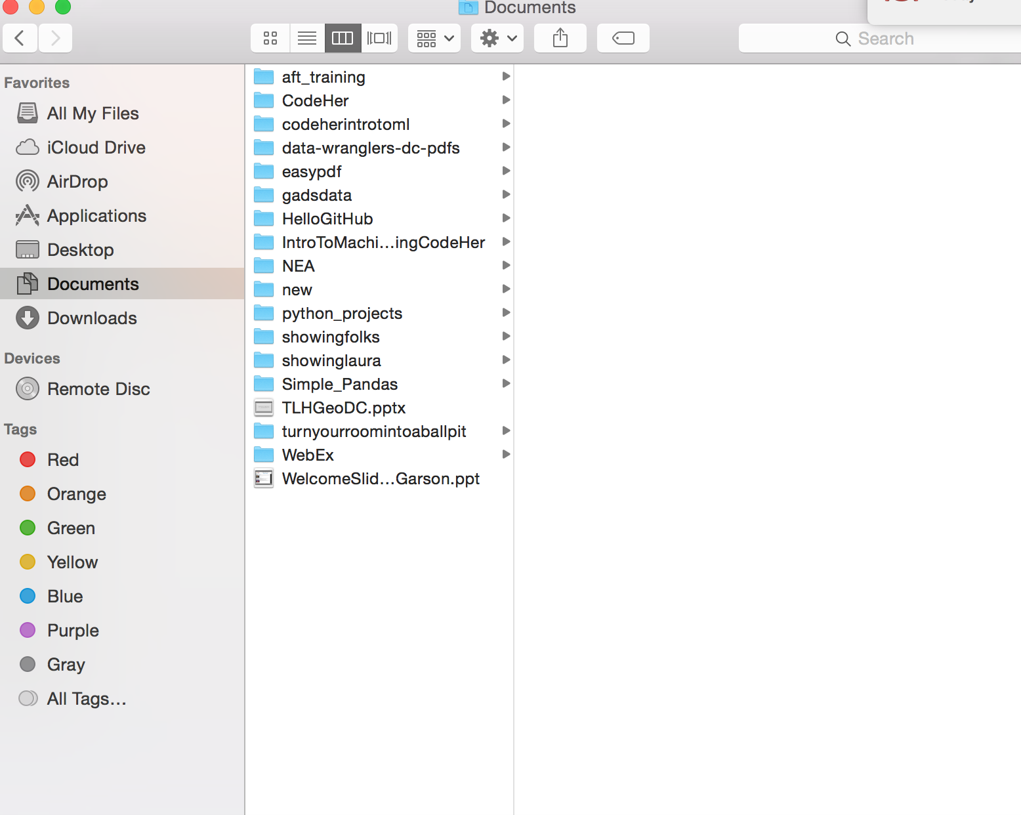
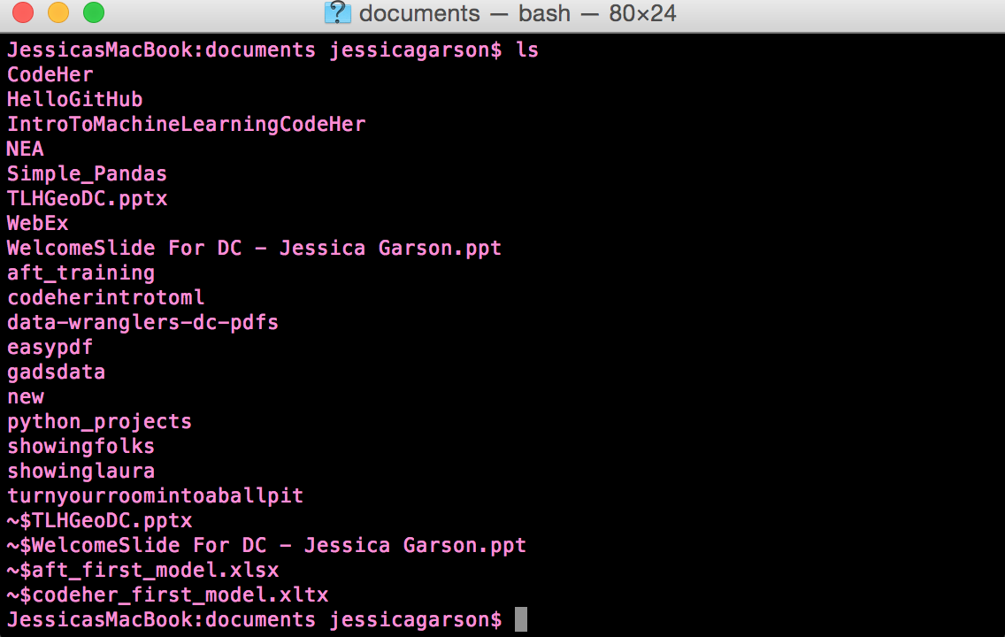
What is the command line?
The command line is a way of interacting with the computer but without the graphical interface we are used to in programs using finder on the computer

Slide 10


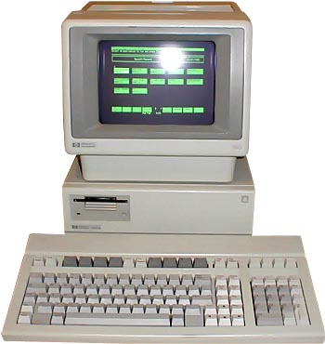
Linux, Unix and Other Systems

Slide 11


Git vs Github

Slide 12

What is Open Source software?

Slide 13
A few other key terms
Bash scripting - A script for a computer tells the computer what it should do or say. In the context of Bash scripts we are telling the Bash shell what it should do. A Bash script is a plain text file which contains a series of commands.
Shell - A shell is a program that provides the traditional, text-only user interface for Linux and other Unix-like operating systems.

Slide 14
What can we build with code
Websites
Games
Predictions
Toys
Wearable tech
Make our lives easier

Slide 15
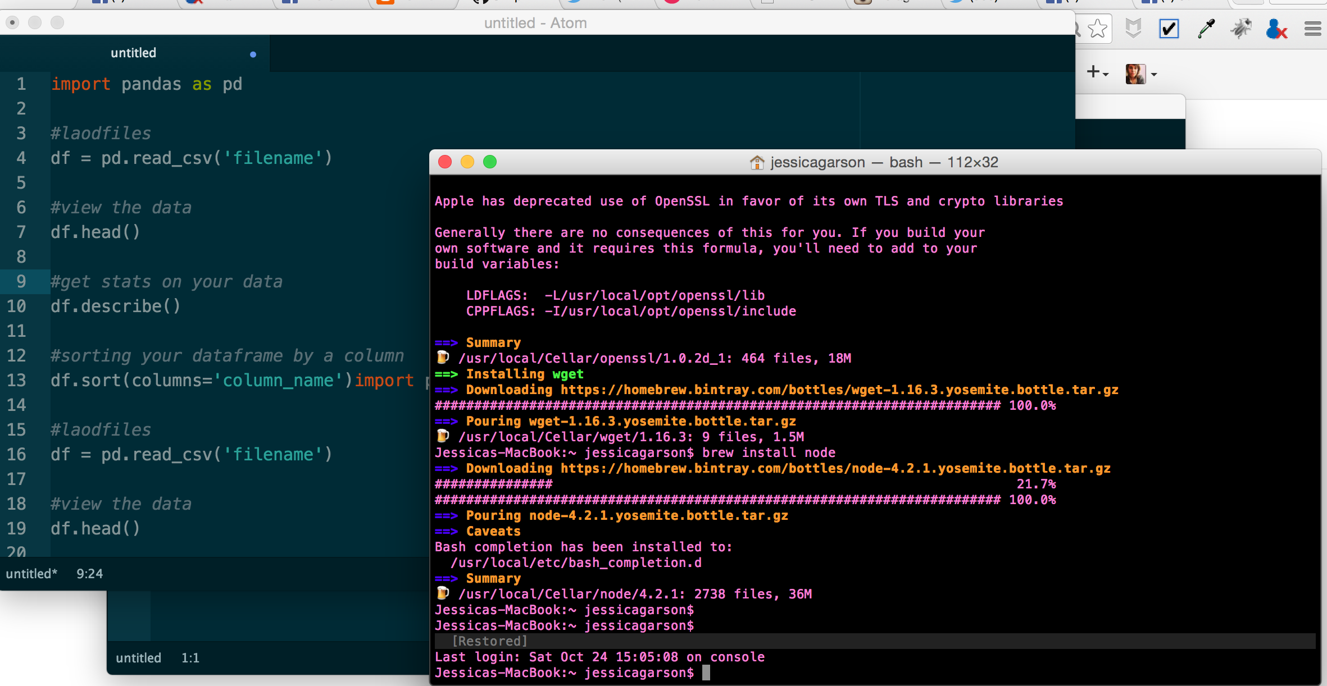
What do you need to code?

Slide 16
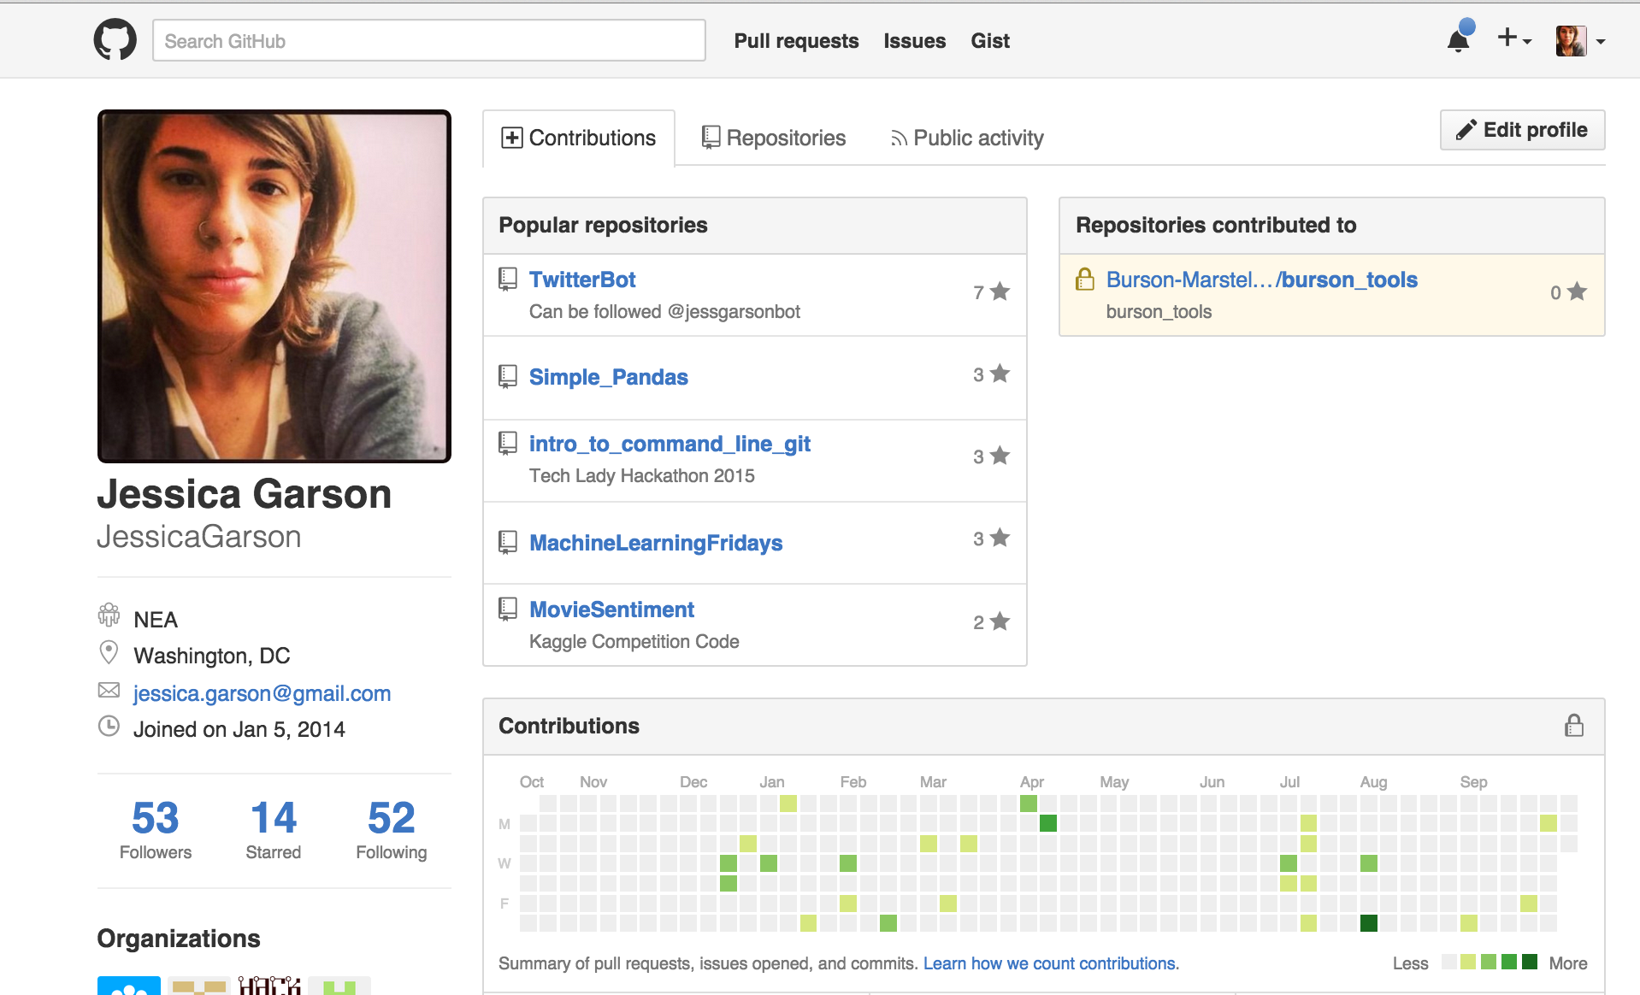
Let’s make our own GitHub profile www.github.com

Slide 17
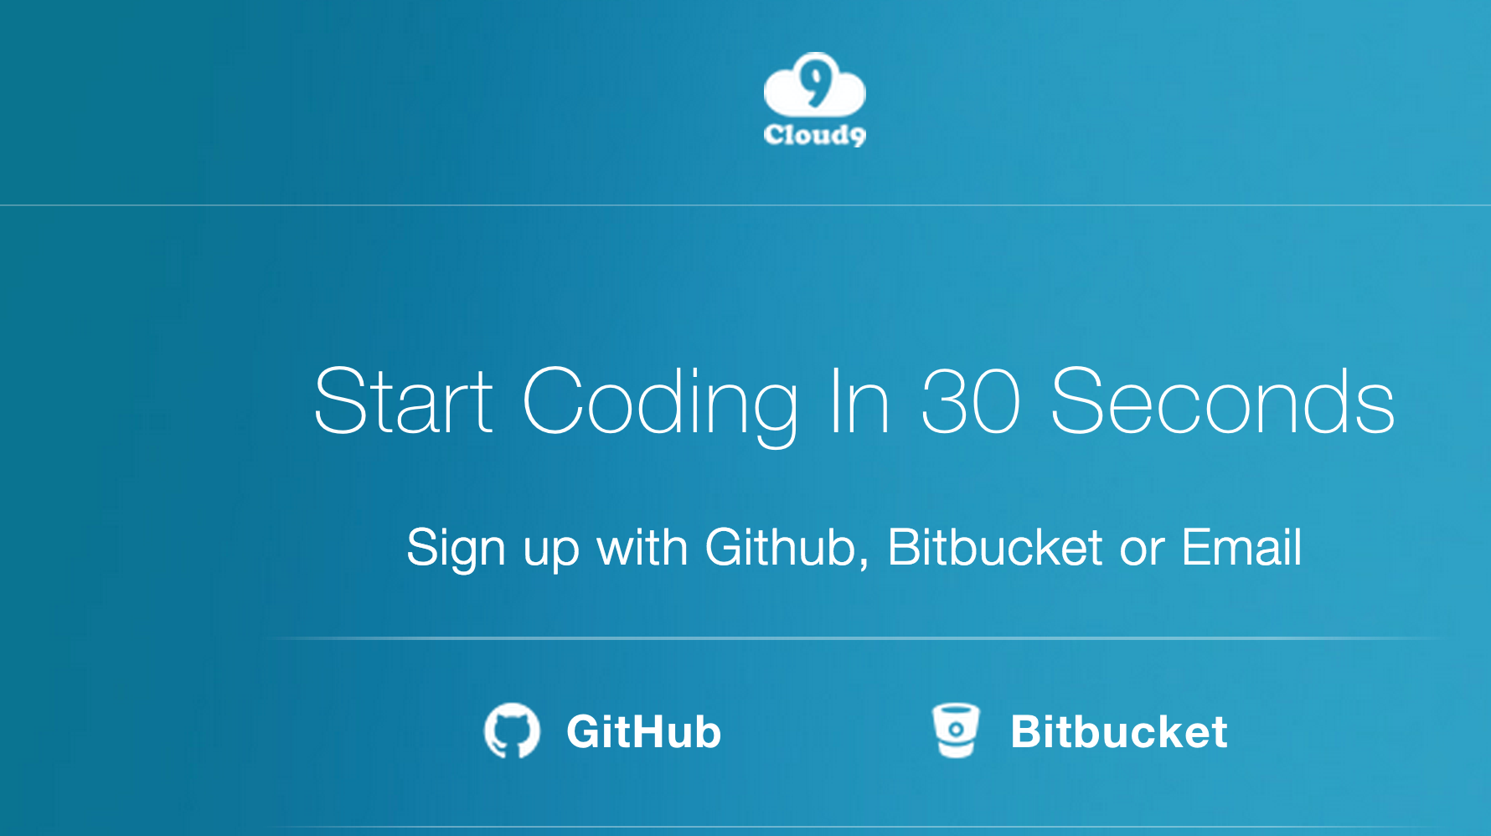
Let’s Create Our Cloud 9 account https://c9.io/web/sign-up/free

Slide 18
Activity – 20 Questions
Let’s as a class play a game
If you don’t remember how to play 20 questions here is a quick recap:
One person thinks of an object and the other player gets to guess up to 20 questions to guess the object

Slide 19
Debrief
What logic did you use to help make a guess?
What strategies were effective?
What strategies proved ineffective?

Slide 20
Computer Concepts We Used
Computational thinking
Linear search
Binary search
Divide and conquer
Comparing algorithms
Notes:
In computer science, a binary search or half-interval search algorithm finds the position of a target value within a sorted array.
In computer science, linear search or sequential search is a method for finding a particular value in a list that checks each element in sequence until the desired element is found or the list is exhausted.

Slide 21
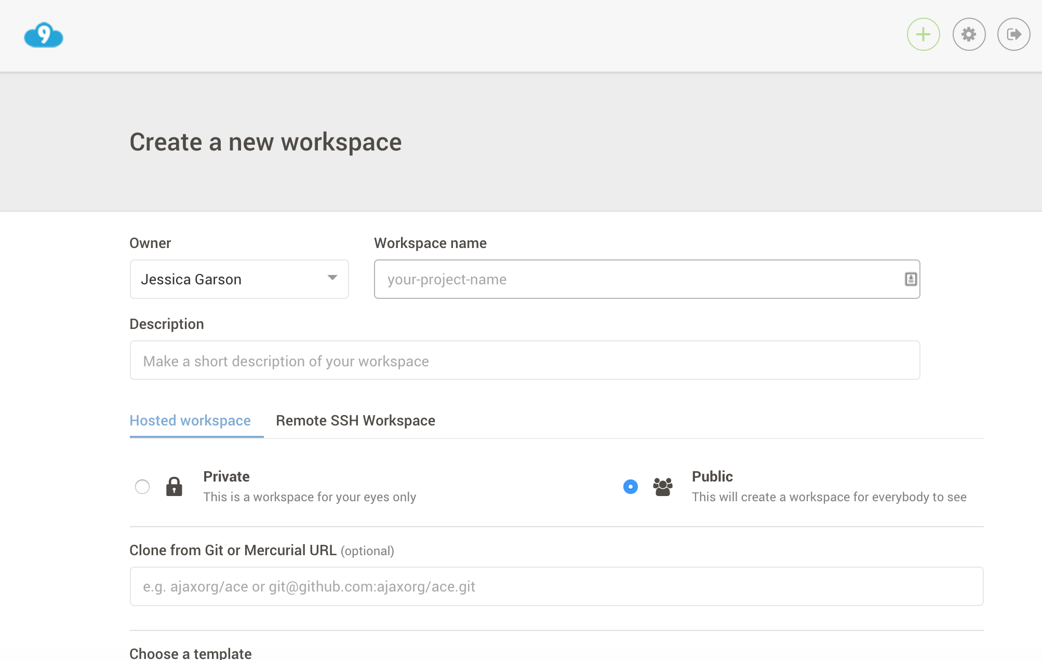
Setting Up in Cloud 9

Slide 22
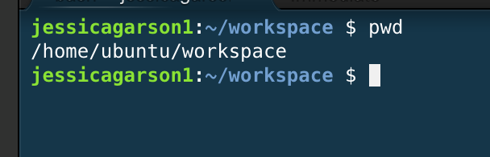
Where am I? pwd

Slide 23
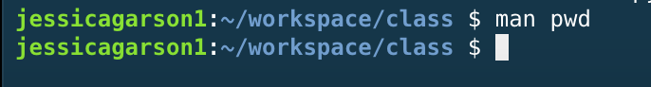
Show the manual page for a command man

Slide 24
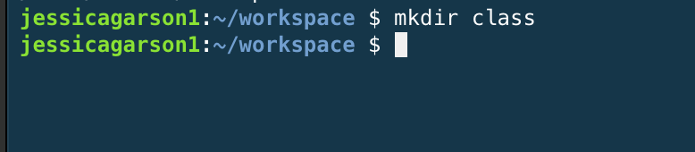
Make a new directory mkdir

Slide 25
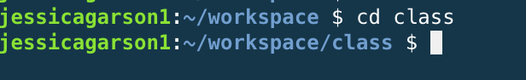
Change Directory cd directory_name

Slide 26
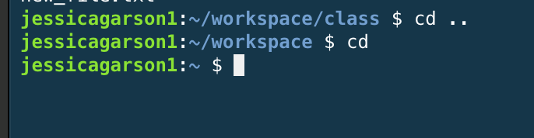
Some key commands for changing directories

Slide 27
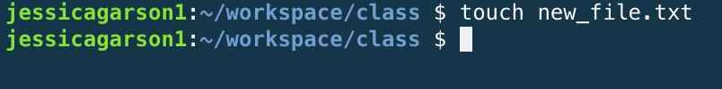
Make new file touch file_name

Slide 28
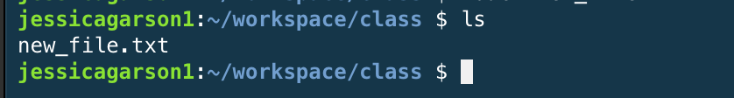
List contents of a directory ls

Slide 29
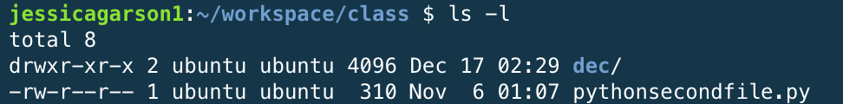
List the longer contents of a directory ls –l

Slide 30
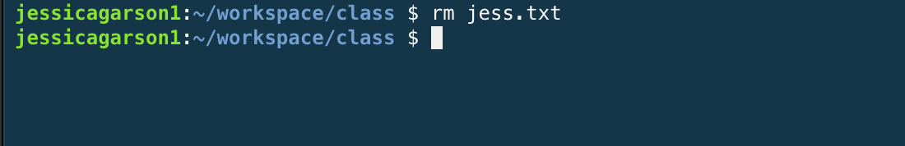
Remove a File rm

Slide 31
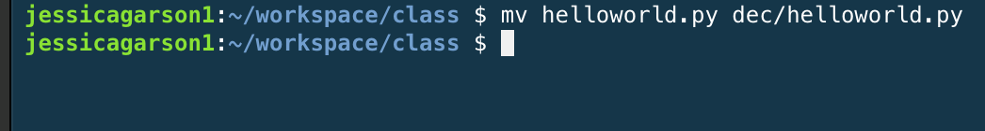
Move a file mv

Slide 32
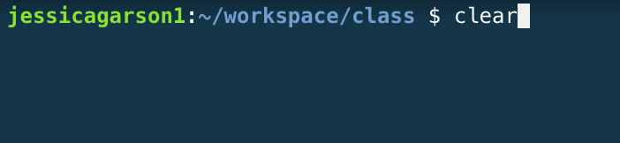
Clear the contents of command line window clear

Slide 33
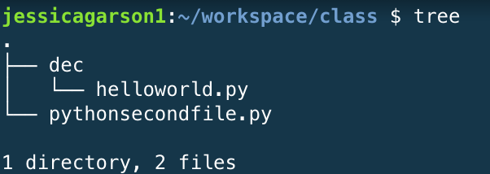
Create a tree diagram of contents Tree

Slide 34
Remove a directory rm –r directoryname

Slide 35
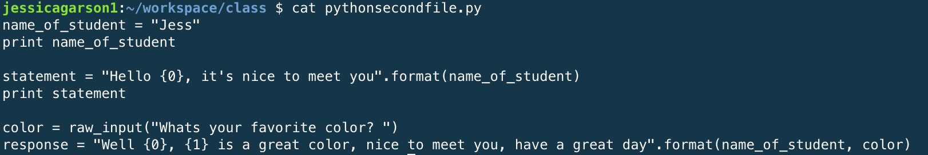
Read a file cat

Slide 36
Tells you how many lines, words and characters there are in a file wc

Slide 37
A few tricks
Tab complete
The up arrow
The down arrow

Slide 38
Let’s Play Around On The Command Line
Let’s take a few minutes to create a few files, move some files and generally play around to get to know the command line.

Slide 39

Our First Python Program

Slide 40
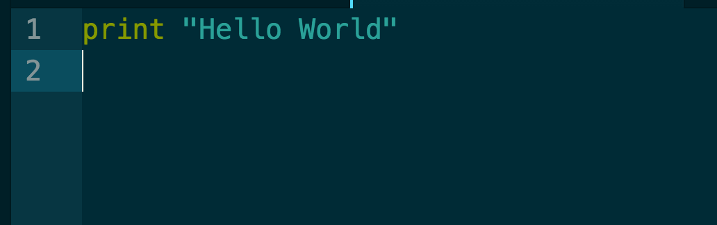
Our First Python Program

Slide 41
Running our first program

Slide 42
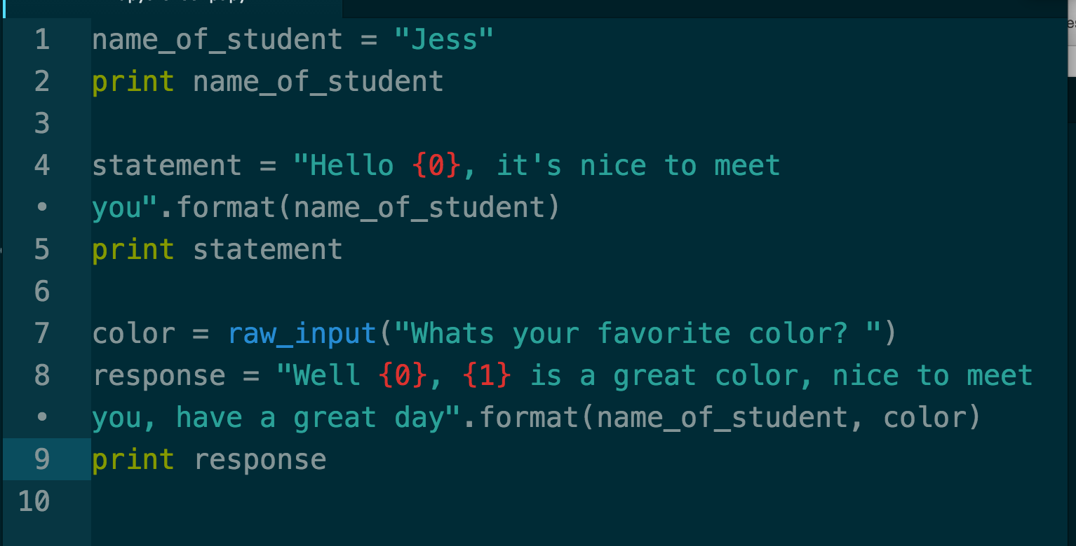
Our 2nd Python Program

Slide 43
My Favorite Thing About Code
There is no right answer here. There are many ways to write a program that accomplishes the same goals in different ways. Feel free to make changes here and make this your own.

Slide 44
Challenge
Create your own text based game

Slide 45
Let’s play and around and adjust the 2nd program
Make changes a you see fit
Run the program when you are ready
Let me know if you have any questions

Slide 46
Do This at Home
Shell Environments
On a mac – there is a Linux environment that comes pre-installed called the terminal
To get to the terminal go to finder select utilities and inside the folder you should
On a PC – There are many options but I really like babun - http://babun.github.io/
Text Editors
Sublime Text - http://www.sublimetext.com/
Atom - https://atom.io/
Notepad ++ for PC only - https://notepad-plus-plus.org/

Slide 47
Installing Python on your Computer – Macs
Python comes bundled with Macs already, so there's no extra setup for now. You'll want to check which version you have, but it's not super important for writing your first scripts.

Slide 48
Installing Python on your Computer – PC and Linux
Running Python in Windows or Linux
Download and install Python from here: http://www.python.org/download/releases/2.7.6/
I prefer to use IDLE (bundled with Python) over the command prompt when possible -- simply put, it's easier to use. If you need to run Python scripts from the command line, the Mac instructions below will work with minimal adjustment.
When you run IDLE, you'll automatically be in the interactive interpreter mode where you can run Python commands one at a time.
To create a new file from IDLE, go to File > New Window. A new, blank screen will open up where you can create your Python projects.
When you have a Python file open in IDLE, you can run it at any time by pressing F5.

Slide 49






The coolest thing about DC right now

Slide 50
A few resources I recommend

Slide 51
Resources for Learning How to Code
What have you tried?
What’s worked well for you?
What hasn’t worked for you?
What can we try?

Slide 52
Questions, Comments, Feedback
Let us know if you have any

Slide 53
Contact
Jessica Garson
Jessica.Garson@gmail.com
Jessica.Garson@bm.com
Twitter: @jessicagarson

